Slide 1
Journey PPT
TECHNICAL TRAINING WEEK -1
21ST AUGUST 2023- 25TH AUGUST 2023

Slide 2
Day-1 BA and Agile
Topics covered:
Introduction to Business Analysis. Requirement Analysis-Functional and Non-Functional, Types of requirements Elicitation, Modelling and Management techniques.
Requirement Traceability, Project management Basics.
Software engineering methodologies, Understand waterfall and Agile methodology and explain the difference. Project management methodologies.
Introduction to agile practices.
Roles in Agile.

Slide 3
Scrums:
we talked about What were Sprints and Why sprint- based model was adopted over traditional models like Waterfall models
End Goals of Sprint Along with various standards and conditions were also discussed
We tried to Understand Terminologies used in scrum model like Scrum manager, Product owner, Dev team etc.
DoR like - Problem Statement Defined, Business Value Identified and Documented, Story Walk-through completed, Requirements Documented & Signed Off, Acceptance Criteria Documented
DoD Like - Effort estimate and Start/End Date logged for each Task, unit test case preparation, BDD – Functional Automation Testing, Development Completed, Unit Testing Completed, Functional & Non-functional Test Validation, Code Review, Code Review Incorporation

Slide 4
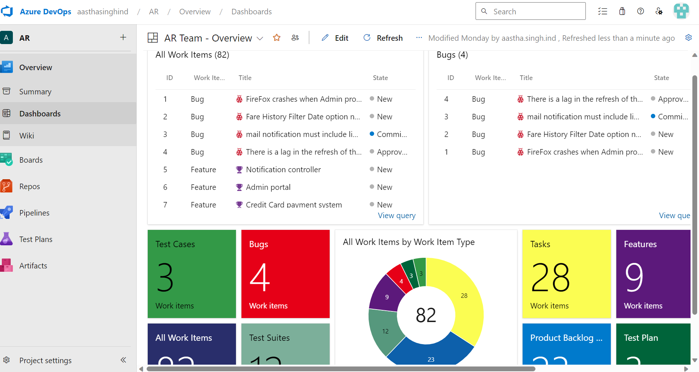
Day-2 BA and Agile.
Instructor led AzureDevOps - Tool Walkthrough.

Slide 5
We discussed the process involved behind Choosing the board for development – Sprint. Ways of Creating / Customizing the process was also discussed using various Group discussions and role-plau scenarios.
We discussed what is product backlog, and performed exercises to derive sprint backlog from product backlogs.
We had group discussions on which backlog to be part of sprint and what could be the various criterions to set up the priority systems governing their acceptance into the Sprints.
We revised and discussed Scrum fundamentals
Capturing these using AzureDevOps

Slide 6
Discussion on what is product backlog, sprint backlog, Scrum fundamentals, knowing people involved in the scrum, roles and responsibilities - Capturing these using AzureDevOps.
How to create a bug, Understanding Workflow. Re-creating bug as a task, and closing/Working. Defect injection and Defect detection.
Track rework efforts. And Create traceability matric to make sure of 100 % requirement coverage.
Understanding roadmap, time & effort estimation, Analysing 8 point story estimation for every sprint
Instructor led – Roadmap basics, What is story points, Time Estimation, Know how 8 point story estimation works

Slide 7
View or configure team velocity. Generate A count of work items completed.Calculate The sum of estimates made to:
- Effort (product backlog items).
- Story Points (user stories).
- Size (requirements).
Learning what Assigned to me (User), Burndown chart (Analytics), Burnup chart (Analytics) mean in the sense of Scrum activities and
Discussed Velocity chart, and concluded the session with final discussion.

Slide 8
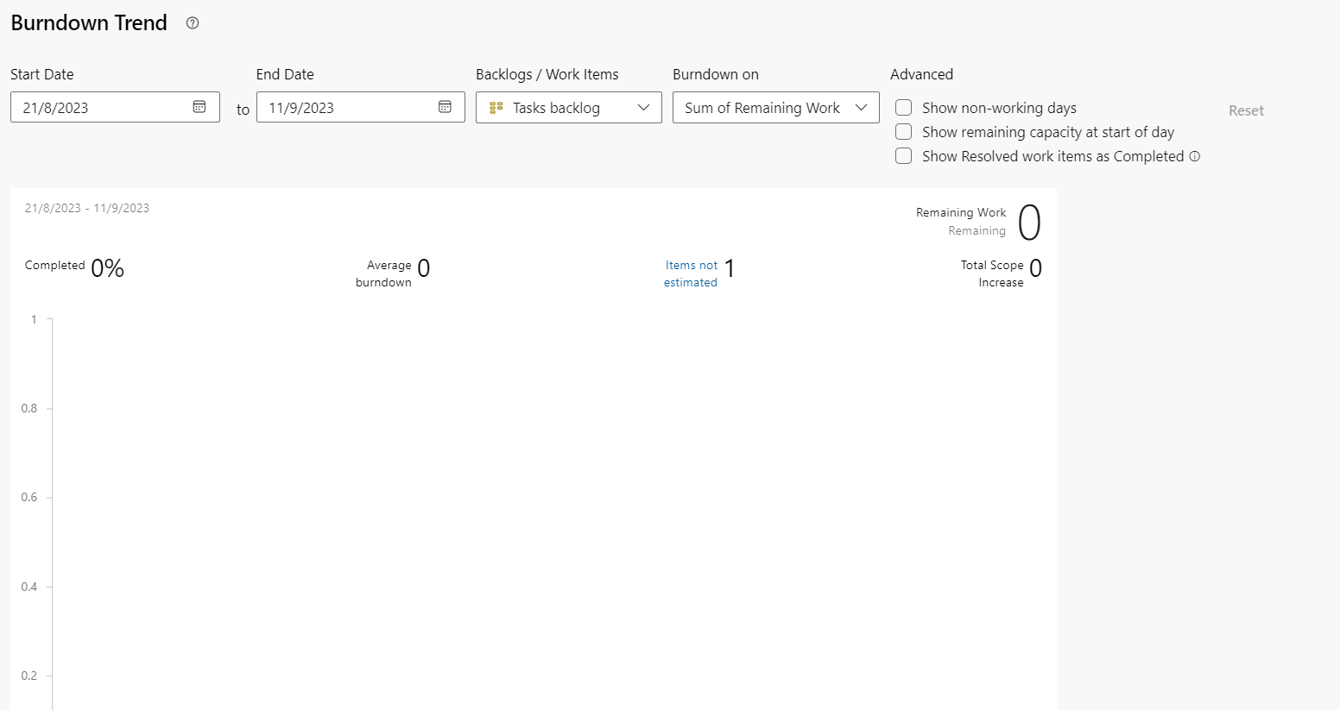

Slide 9
Day 3
Understand Software Testing, Needs and Psychology for Software Testing
How does Testing play an important role throughout the software cycle
Software Test Life Cycle, SDLC v/s STLC, Understanding Testing Triangle. Comparing ideologies of TDD/BDD/ATDD/DDD/MDD.
We were given an Introduction to manual testing, automation, unit, regression, system, Integration, UAT, etc.
Differentiate between white / Grey / Black box testing

Slide 10
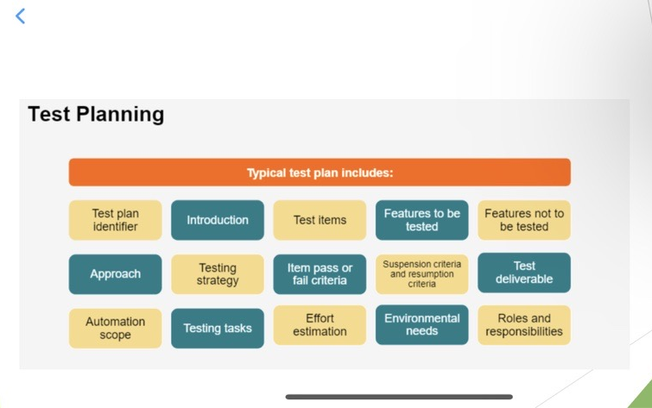

Slide 11
Day 4 SQL and DBMS
We were given Introduction to DBMS and its importance in project work. We established Difference between DB, DBMS, and RDBMS
We discussed what is Normalization, the need for normalization for eradicating delicacy.
We discussed various types of normalization.
We learned about NoSQL and PostgreSQL.

Slide 12
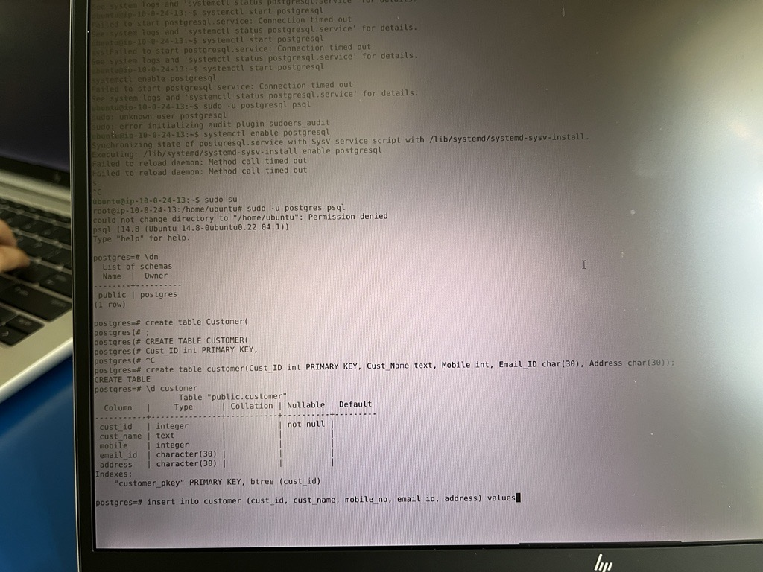
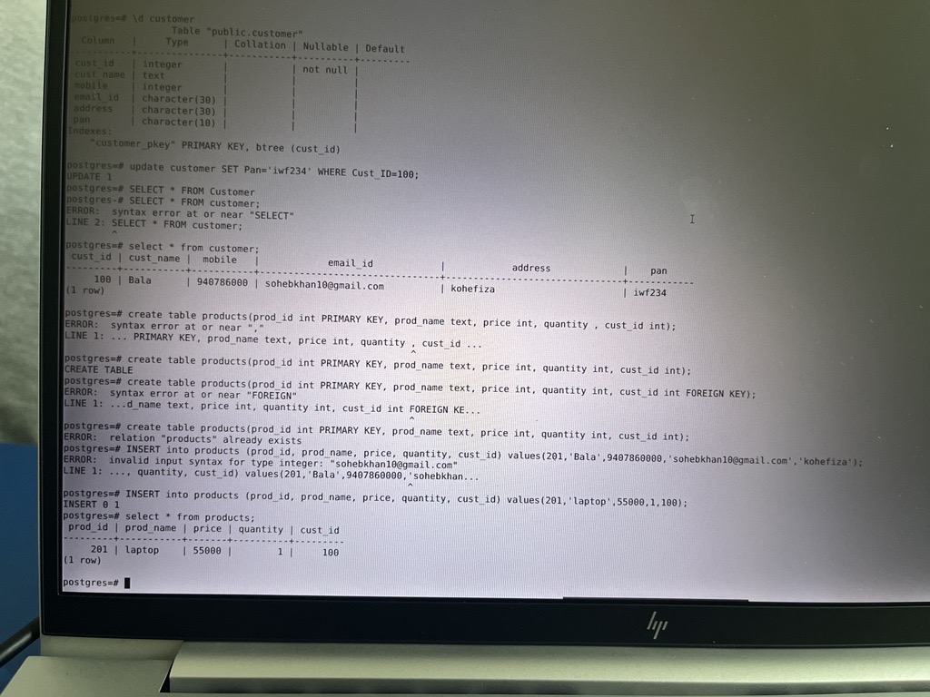
SQL IMAGES

Slide 13
Day 5 Devops
We had an Introduction to DevOps and its importance in Software Development
We discussed a bit about DevOps Life Cycle and its different stages

Slide 14
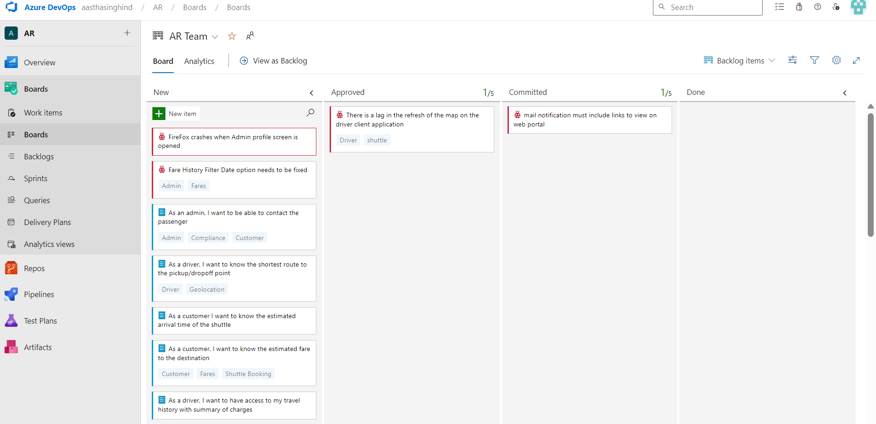

Slide 15
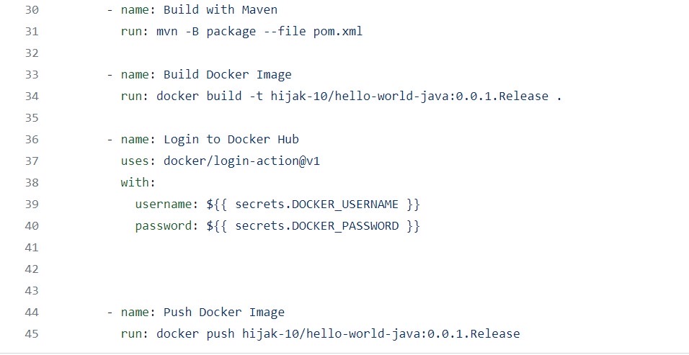
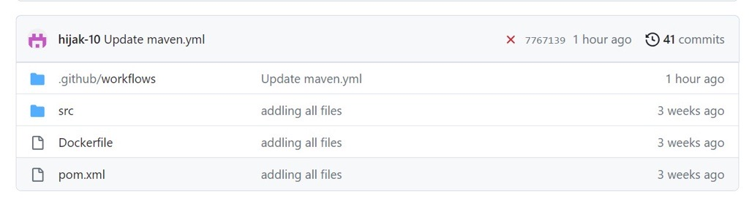
DevOps Tools-Github actions
DevOps Stages

Slide 16
